Slide 1
Project Delivery Overview
June 2015

Slide 2
Planner/Project Management Concept
Project Management Concepts
Step 1: Needs Development
Step 2: Scope Development
Step 3: Selection of Design Team
Step 4: Design Phase
Step 5: Selection of Contractor
Step 6: Construction Phase
Step 7: Transition, Activation and Closeout
Wrap-Up Summary

Slide 3
Planner/Project Management Concepts
Three distinct areas to be aware of:
Statute
Code compliance, city permits
and applicable regulatory requirements
Policy
University/WUMC, WUSM Policies
Process
Developed by the University and FMD departments to ensure efficiency and compliance with above referenced statutes and policies

Slide 4
Planner/Project Management Concepts
The title “Planner/Project Manager”, while emphasizing the importance of overseeing and monitoring a project, can cause one to overlook other leadership skills needed to successfully lead a project to completion. A Planner/Project Manager has leadership and management obligations. There are six major responsibilities associated with the roles of manager and leader.
1. Focus on the Customer and University Stewardship Role
2. Create the Project Vision
3. Build and Maintain the Project Team
4. Plan the Project
5. Managing Resources (Budget, Time & Quality)
Ensuring Quality
Communicate, Communicate, Communicate
Minor & Planned Projects

Slide 5
Planner/Project Management Concepts
A “customer” is a person or organization that is the primary user of the end product or service.
A “stakeholder” is a person or organization that has a stake or interest in the project.
The “executive team” is a group of people that have the final contractual or project cost approval authority.
A “neighbor” is a person or organization whose facility or interest normally border or touch a project or project site.
Minor & Planned Projects

Slide 6
Planner/Project Management Concept
Additional keys to successful project delivery include:
Well-developed and endorsed project work plan
Project tools
Performance measures and metrics (Quality)
Project chartering and project contact list at the start of the project
Continual and consistent contact
Meeting minutes
Establish and meet your major milestones
Communication
The benefits of a well-developed project delivery process are satisfied customers and stakeholders who receive high-quality projects that routinely meet expectations, costs, and schedule goals; and a consistent customer focus that is adaptable to ever-changing demands and challenges.

Slide 7
Project Process Overview
Manage Deliverables
Initiate the Project
Plan the Project
by Phase
Procure Services/ Products
Close the Phase
Close the Project
Manage Project Changes
Perform Project Controls

Slide 8
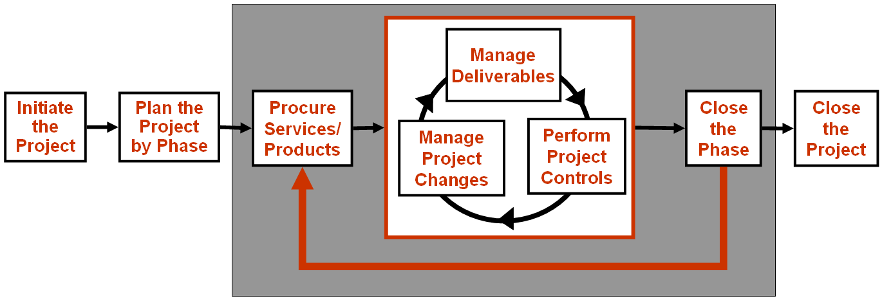
Step 1: Needs Development
Project Request Received
Project request vetted for assignment
Project request assigned

Slide 9
Step 1: Needs Development
All Facilities Management Department projects can begin in one of the following ways:
Planning and Project Request Form on FMD Website
Online Work Request (ServiceNow) on FMD Website
Customer Requests Via Phone or Email to Facilities Integrated Service Center
Capital Renewal Request
Emergencies
Capital Planning Process
The “Needs Development” step in the project delivery process refers to when a project is assigned to a Planner/Project Manager in FMD.

Slide 10
Step 2: Scope Development

Slide 11
Step 2: Scope Development
The focus of this step is preparing the project charter and initial project scope.
Chartering is a structured process used to guide the project team through the defining the project purpose, critical success factors, goals, roles and responsibilities and other elements that ensure a high-quality performance.
This phase includes developing the project definition and vision, establishing the Project Team, defining project objectives and requirements, and project set-up in the work management system.
At the end of this step, the project will have received all customer approvals and funding authorizations.
All projects should have a charter – even small ones!!! – Scale to accommodate size & scope!

Slide 12
Step 3: Selection of Design Team
Choose selection method (direct select or RFP)
Follow documented process
Selection & award
Approval and Reporting
Negotiate Contract
Complete Contracts
Prepare for next phases

Slide 13
Step 3: Selection of Design Team
This phase includes procuring the design products and services required for successful project design delivery.
The two primary methods of procuring these services are:
Direct Selection Architect/Engineer – Informal Process
Request for Proposal (RFP) process
If a commissioning agent will be utilized, this service should be selected parallel to the selection of the design team and engaged throughout the life of the project.

Slide 14
Step 4: Design Phase
Design Kick off & Chartering
Program verification
SD - DD -CD
Prep & Review
Validate other design elements
Final document review and approval
Field investigation and environmentals

Slide 15
Step 4: Design Phase
Continuously monitoring the scope of work being designed and comparing it to the scope of work planned and budgeted is critical.
The Planner/Project Manager proactively ensures that the project meets expectations within the defined constraints, including delivering a project on time and on budget. As a result of managing deliverables, change may be deemed necessary.
All designs should adhere to the WUSM Design Guidelines and Standards. Any variance must be presented and approved by the Project Team and a signed variance form must become part of the project record. No exceptions!

Slide 16
Step 5: Selection of Contractor
Select delivery method
Assemble list of bidders
Follow selected delivery process
Bid
Interview and/or select qualified contractor
Complete Contracting
Prep for next phase

Slide 17
Step 5: Selection of Contractor
This phase includes procuring the construction products and services required for successful project delivery.
Methods of contractor selection include:
Design-Bid-Build
CM – GMP with Guaranteed Maximum Price
CM – At Risk
In-House Renovations (Owner Provided Service)
Continuing Services (utilizing Continuing Services Agreement)
This phase also includes the procurement of Owner Provided Services.

Slide 18
Step 6: Construction Phase
Kick off meeting and deliverables review
Site Mobilization
Manage deliverables and pay invoices against schedule of values
Project controls and change management
Punch list and approve deliverables

Slide 19
Step 6: Construction Phase
Continuously communicating and monitoring the scope of work being constructed and comparing it to the scope of work that was designed is critical.
The Planner/Project Manager proactively ensures that the project meets expectations within the defined constraints, including delivering a project “on time and on budget.” Inspections of work should take place throughout this phase.
As a result of managing deliverables, change may be deemed necessary. Developing appropriate guidelines and processes for addressing change is crucial to a successful project.
Changes must be tracked by the “Category” of change and reported during each monthly report as well as summarized at the end of the project by category, amount and % of Total Construction Budget.

Slide 20
Step 7: Transition, Activation and Closeout
Activation and Transition
Closeout
Final Payments
& Project Closeout
Substantial completion & occupancy
Record documents
Validate Final Deliverables
Customer Transition Plan

Slide 21
Step 7: Transition, Activation and Closeout
Project transition, activation and close-out captures the last construction-related issues including customer transitions, building systems activation, systems training, administrative (collection/distribution of Operations and Maintenance Manuals, Warranties and all other project documents), financial and contracts closeout and collecting project evaluations and assessments.
A Project is not considered closed until this step is complete. This is critical to the PM/Planners annual performance evaluation. PM’s will not be eligible for the annual bonus program if projects are not closed out correctly and timely.

Slide 22
Other Items of Significance
Project Reporting & Close Out Form
Weekly Project Highlights
Records retention
Non Emotional, Factual & Brief Communications
Encourage person-to-person communication (pick up the phone)
Own the Message…
Know when to Escalate!
Performance & Quality Matters!

Slide 23
Wrap Up
Keys to Success:
UTILIZE YOUR PROJECT DELIVERY MANUAL & YOUR PLANNER/PM TOOLS!
Communication
Resource Management
Change Management
Project Tools
Support Processes
Closeout & Reporting

Slide 24
Questions / Discussion

